Slide 1

HACKATHON PROJECT
FINDING HOSPITALS
April 2021

Slide 2

Objectives
Search for Hospitals
Display Top Cities
Corporate Wellness
2
@ HACKATHON EXPRESS

Slide 3



Description
1
Tstcases
Documents
2
Display Hospitals that are Open 24/7 and has Parking facility with rating more than 3.5 ,for Bangalore City.
Pick all the top cities name from the diagnoistics page and store the names in a list and display the list.
Go to Corporate Wellness and fill invalid details, schedule and capture the warning message from the alert box.
POM
TestNG
3
Maven
Jenkins
4
Results
Reports

Slide 4


Technologies
Jenkins
Git HUB
Jenki
Maven
Maven
TestNG
TestN
POM
POM
Selenium

Slide 5

Workdone
The code is written in JAVA programming language and then is further automated using Selenium.
Page Object Model(POM) is used to reduce the code duplication for various instances.
Data driven is implemented from Excel Sheet using Apache POI.

Slide 6
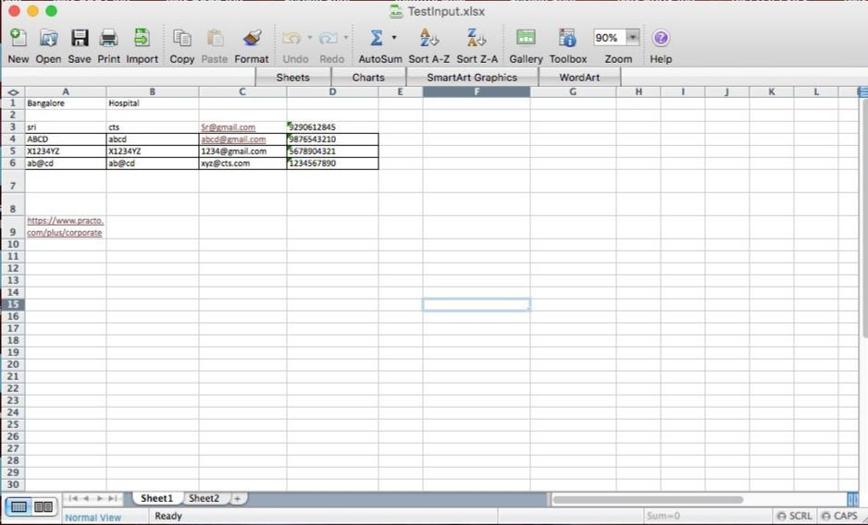
Input.xlsx

Slide 7
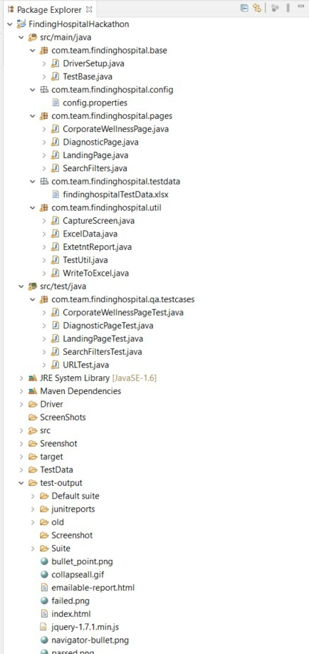
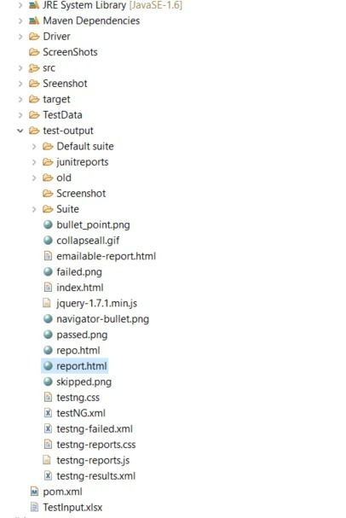
Project Structure
@ HACKATHON EXPRESS

Slide 8
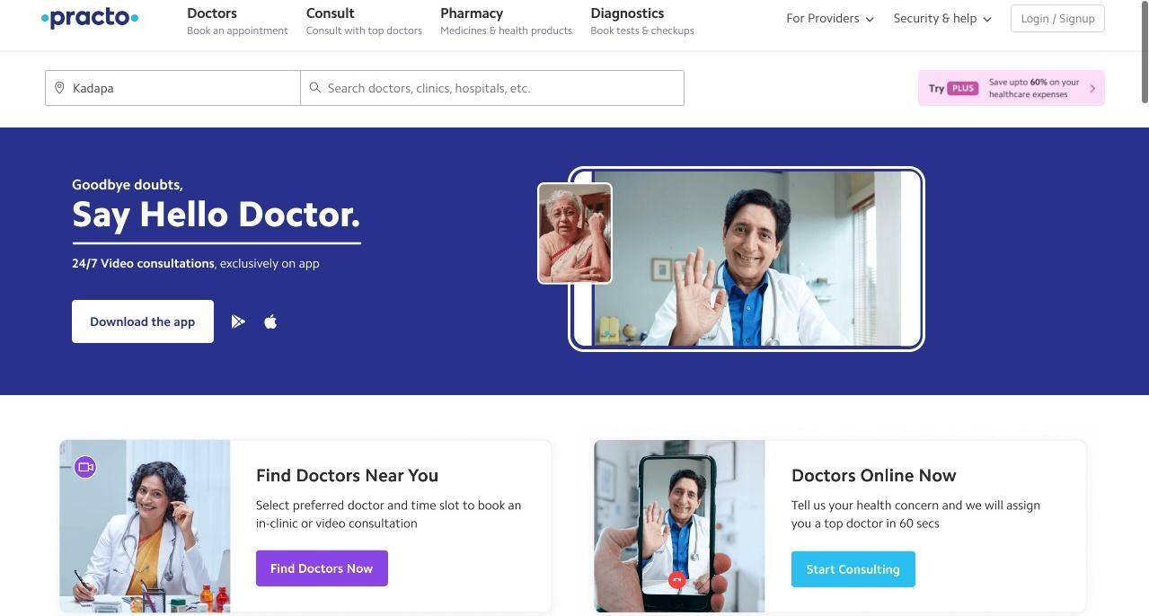
Website(www.practo.com)

Slide 9
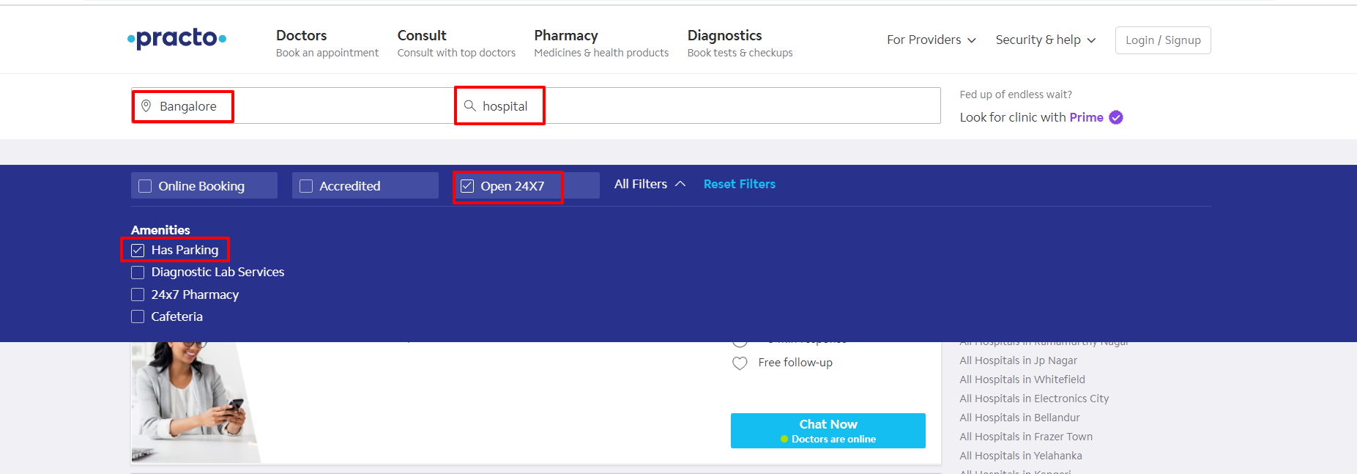
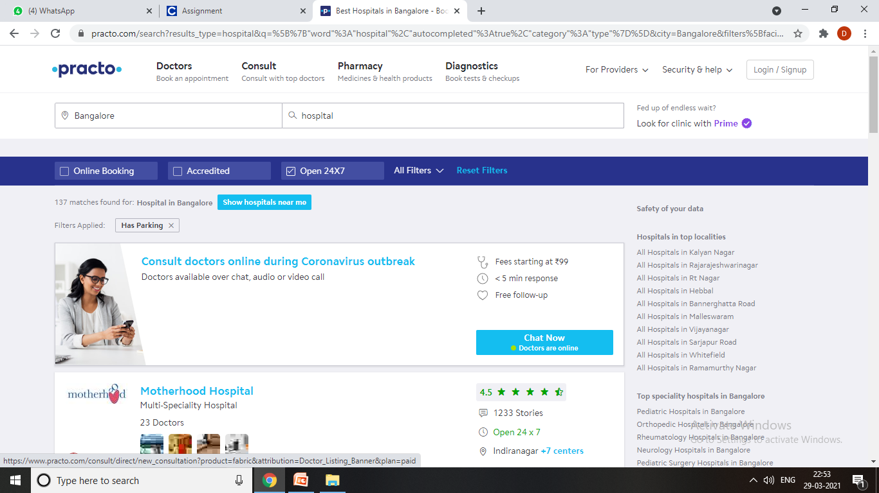
Search for Hospitals
@ HACKATHON EXPRESS

Slide 10
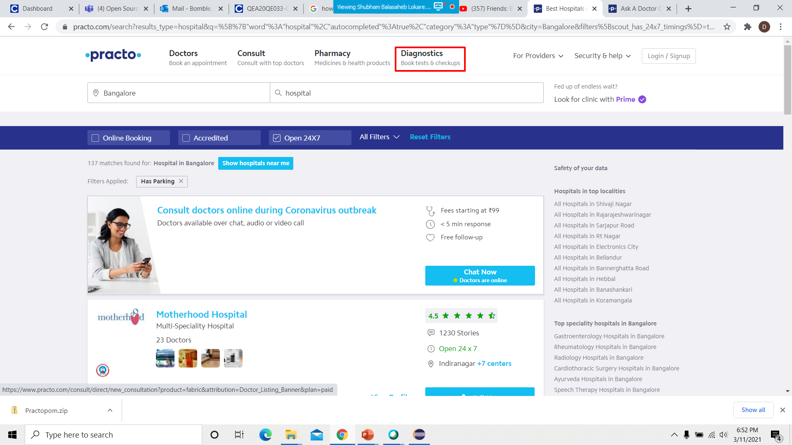
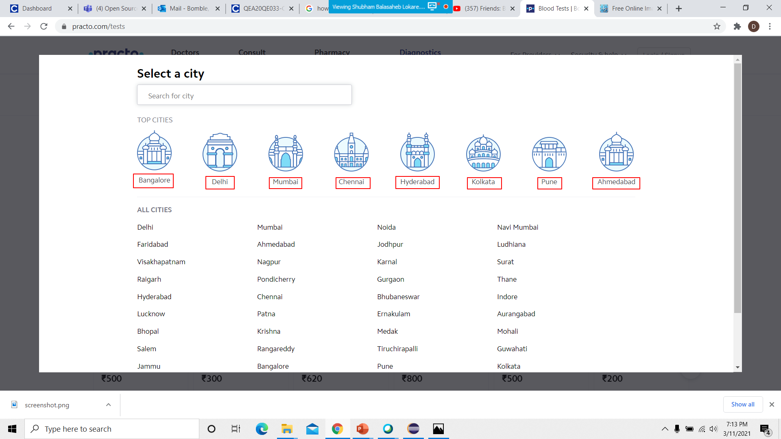
Diagnoistics page

Slide 11

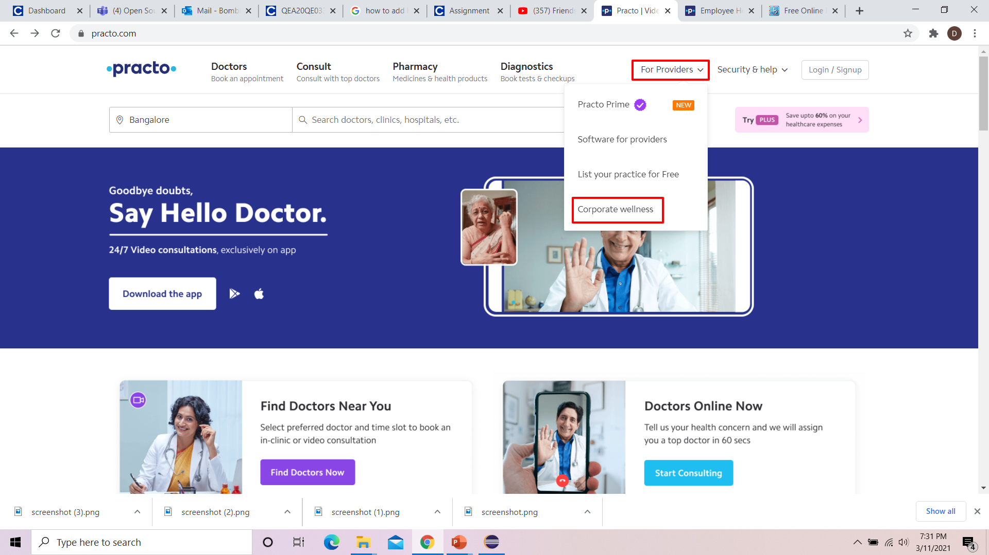
Corporate Wellness

Slide 12


Form Validation
With Valid Details

Slide 13
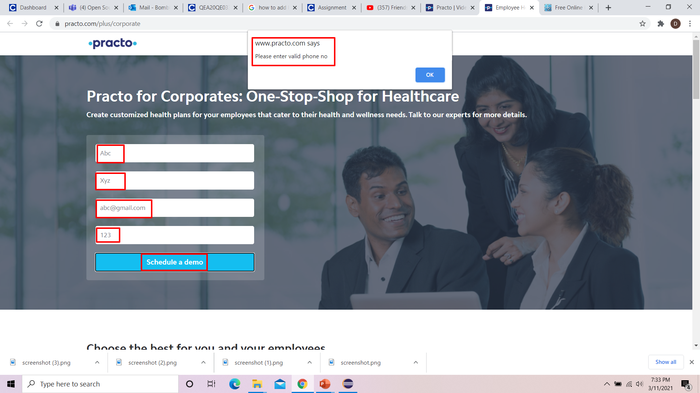
Form Validation
Give invalid details and “Schedule” it. Capture the “Alert” message.

Slide 14
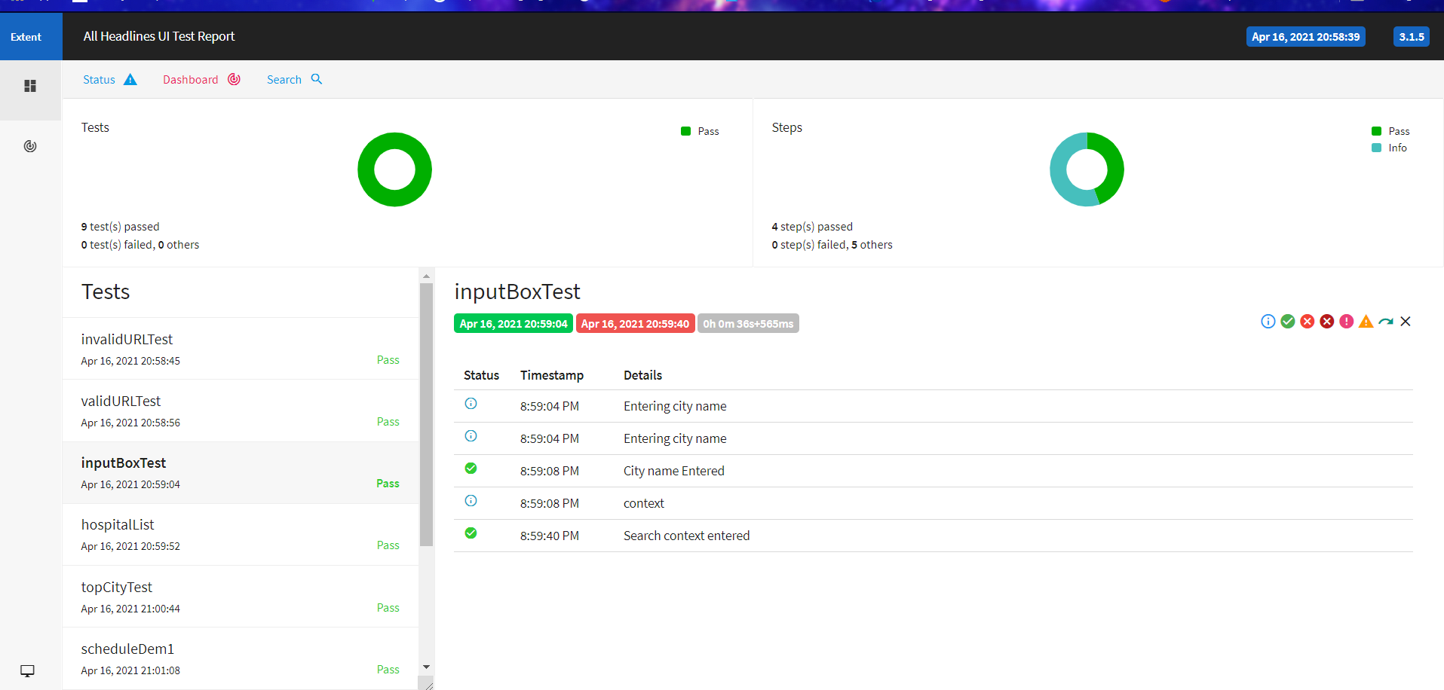
Output

Slide 15


Slide 16
OUR TEAM CREW
Rashmitha Reddy
Aileni
Srikanth Burra
Vuppalapati
Niharika
1
2
3
Sreeja Reddy Nomula
4
Sonia Banu
Shaik
Mohammed
5

